Slide 1
Advanced Data Modeling
CT004-3.5-3
Advanced Database Systems

Slide 2
Topic & Structure of Lesson
The relevance of data modelling to the relational model
Problems with ER Models
Developing Enhanced Entity Relationship Modelling
Specialization/generalization hierarchies

Slide 3
Learning Outcomes
By the end of this lesson you should be able to:
Explain the relevance of data modelling to the relational model
Explain and develop enhanced Entity Relationship Modelling
Describe specialization/generalization hierarchies

Slide 4
ER Modelling
ER Modelling is a very effective tool for standard relational DB tasks
Provides semantic information but not always sufficient
Less adapted for more complex semantics

Slide 5
The Database Design Process
Requirements Definition
Data Analysis
Conceptual data model
Logical data model
Physical Design
Database

Slide 6
Problems with ER Models
Problems may arise when designing a conceptual data model called connection traps.
Often due to a misinterpretation of the meaning of certain relationships.
Two main types of connection traps are called fan traps and chasm traps.

Slide 7
Problems with ER Models
Fan Trap
  - Where a model represents a relationship between entity types, but pathway between certain entity occurrences is ambiguous.
Chasm Trap
  - Where a model suggests the existence of a relationship between entity types, but pathway does not exist between certain entity occurrences.

Slide 8

An Example of a Fan Trap
Notes:
One or more than one staff can be located in one division only.
One division only can operate one or more branches.

Slide 9
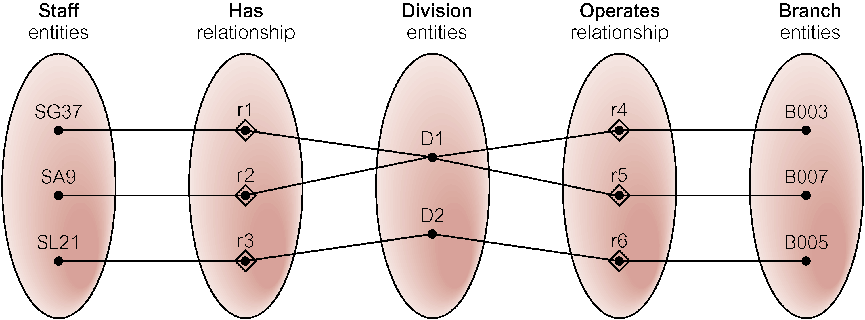
Semantic Net of ER Model with Fan Trap
At which branch office does staff number SG37 work?

Slide 10
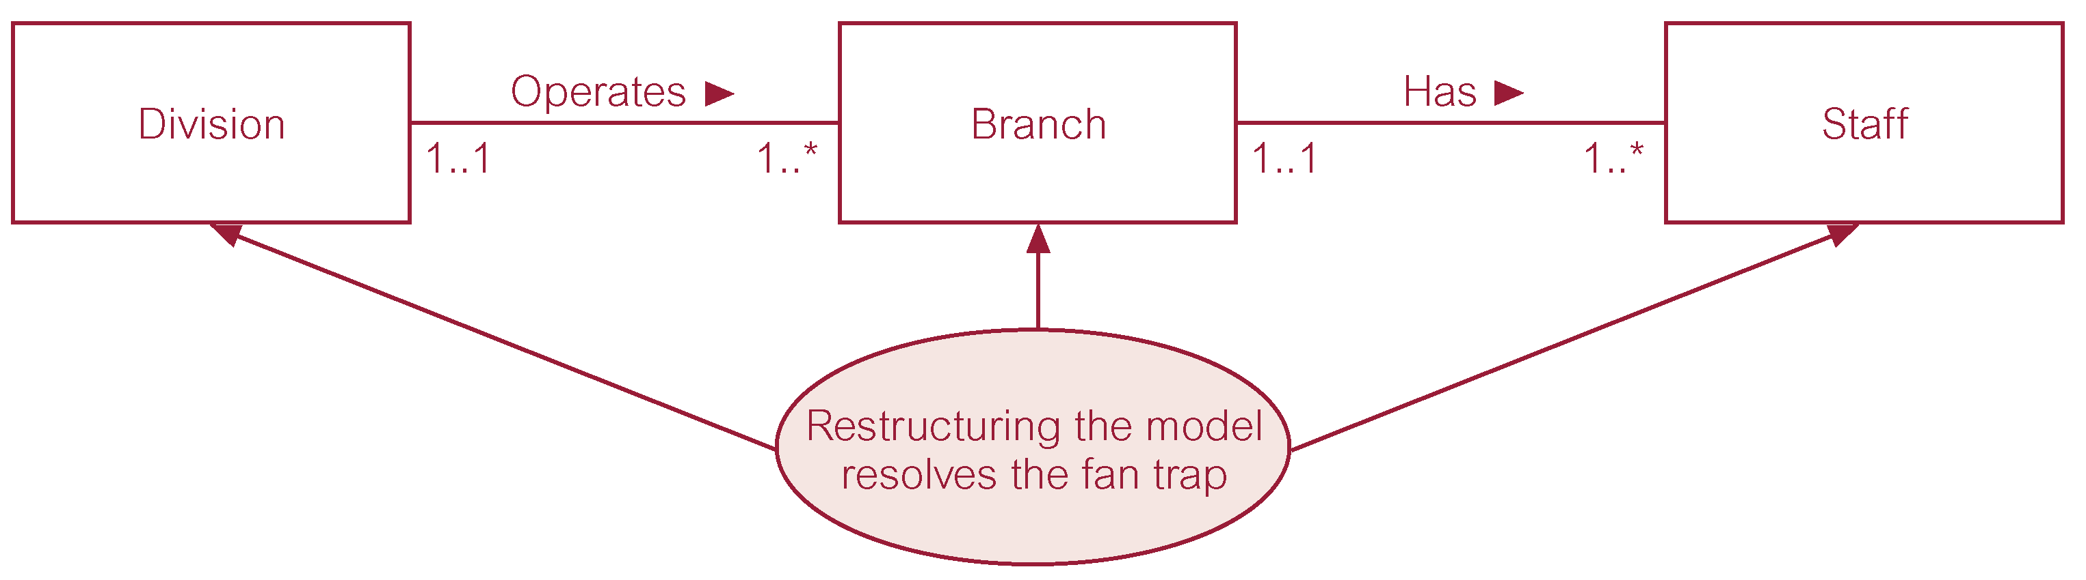
Restructuring ER model to remove Fan Trap

Slide 11
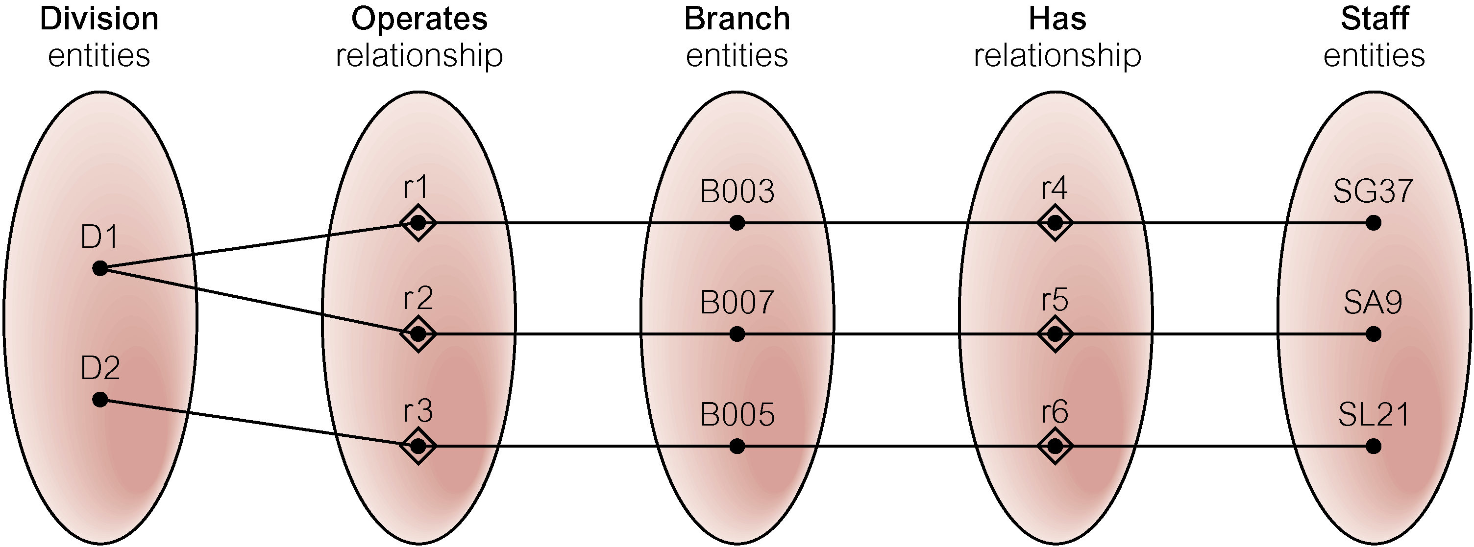
Semantic Net of Restructured ER Model with Fan Trap Removed
SG37 works at branch B003.

Slide 12

An Example of a Chasm Trap
Notes:
One branch only has one or more than one staff
Zero or one staff can oversees Zero or more than Zero property for rent
Zero or more than Zero can be oversees by zero or one staff only

Slide 13
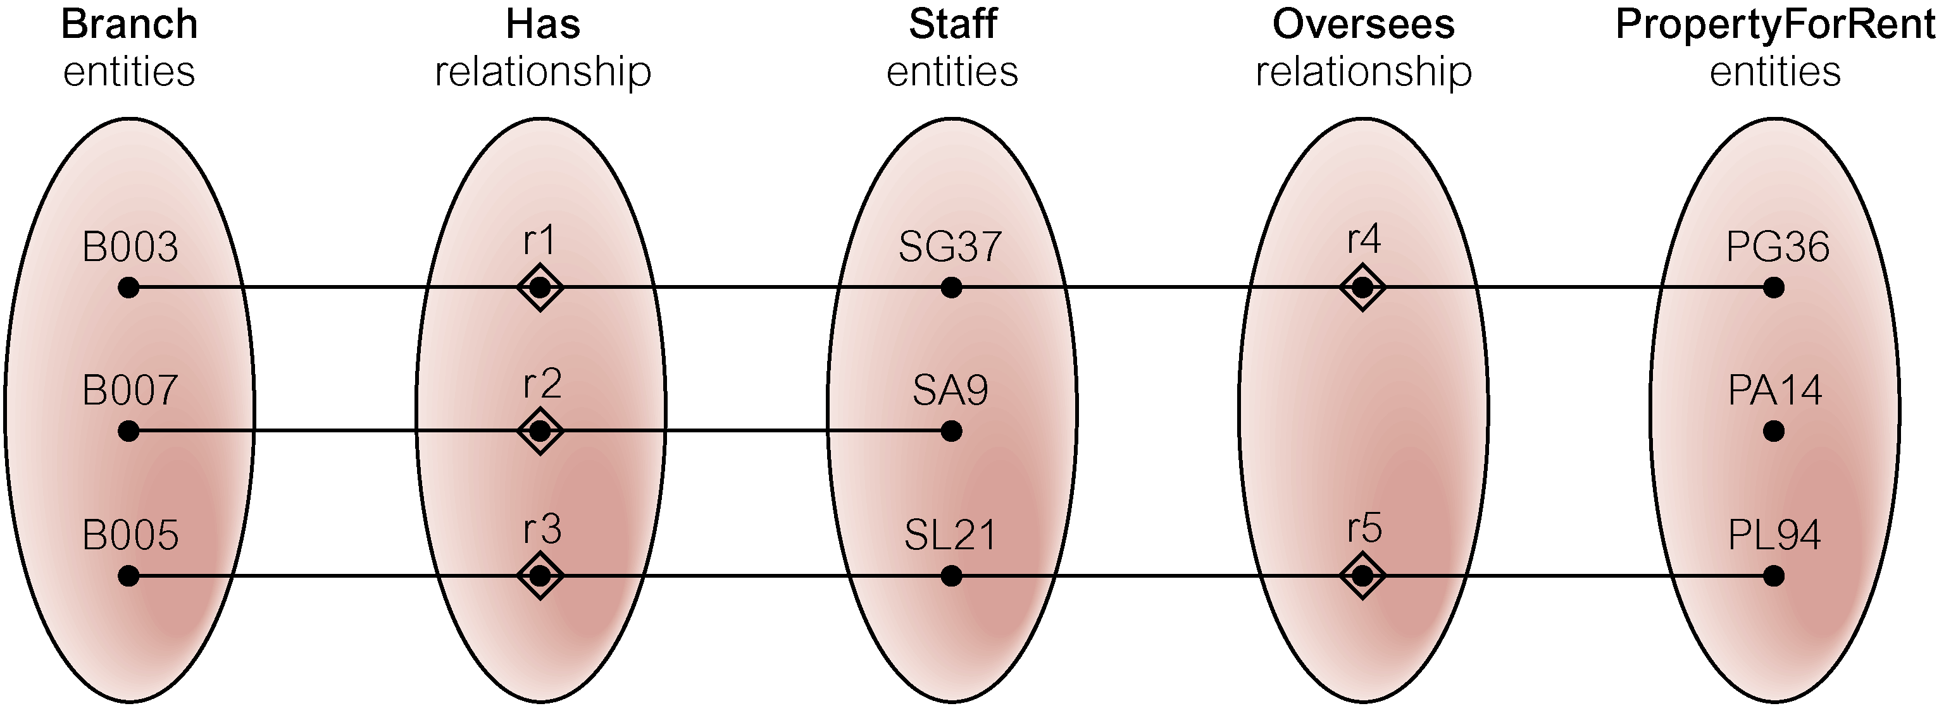
Semantic Net of ER Model with Chasm Trap
At which branch office is property PA14 available?

Slide 14
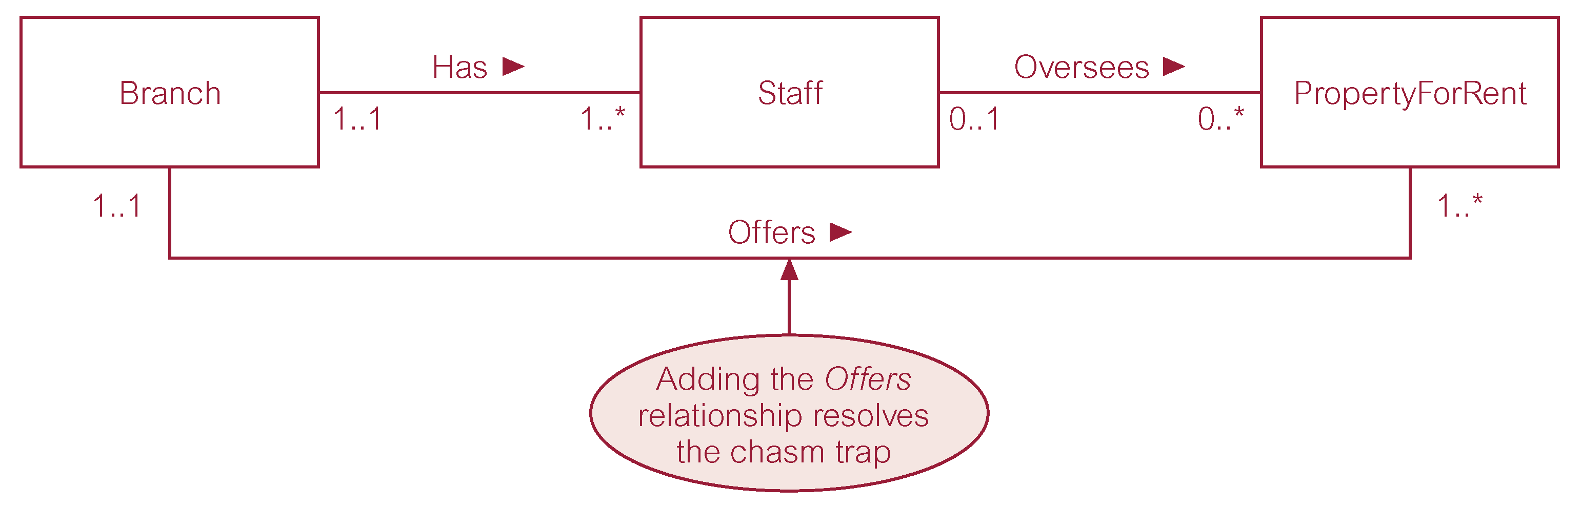
ER Model restructured to remove Chasm Trap

Slide 15
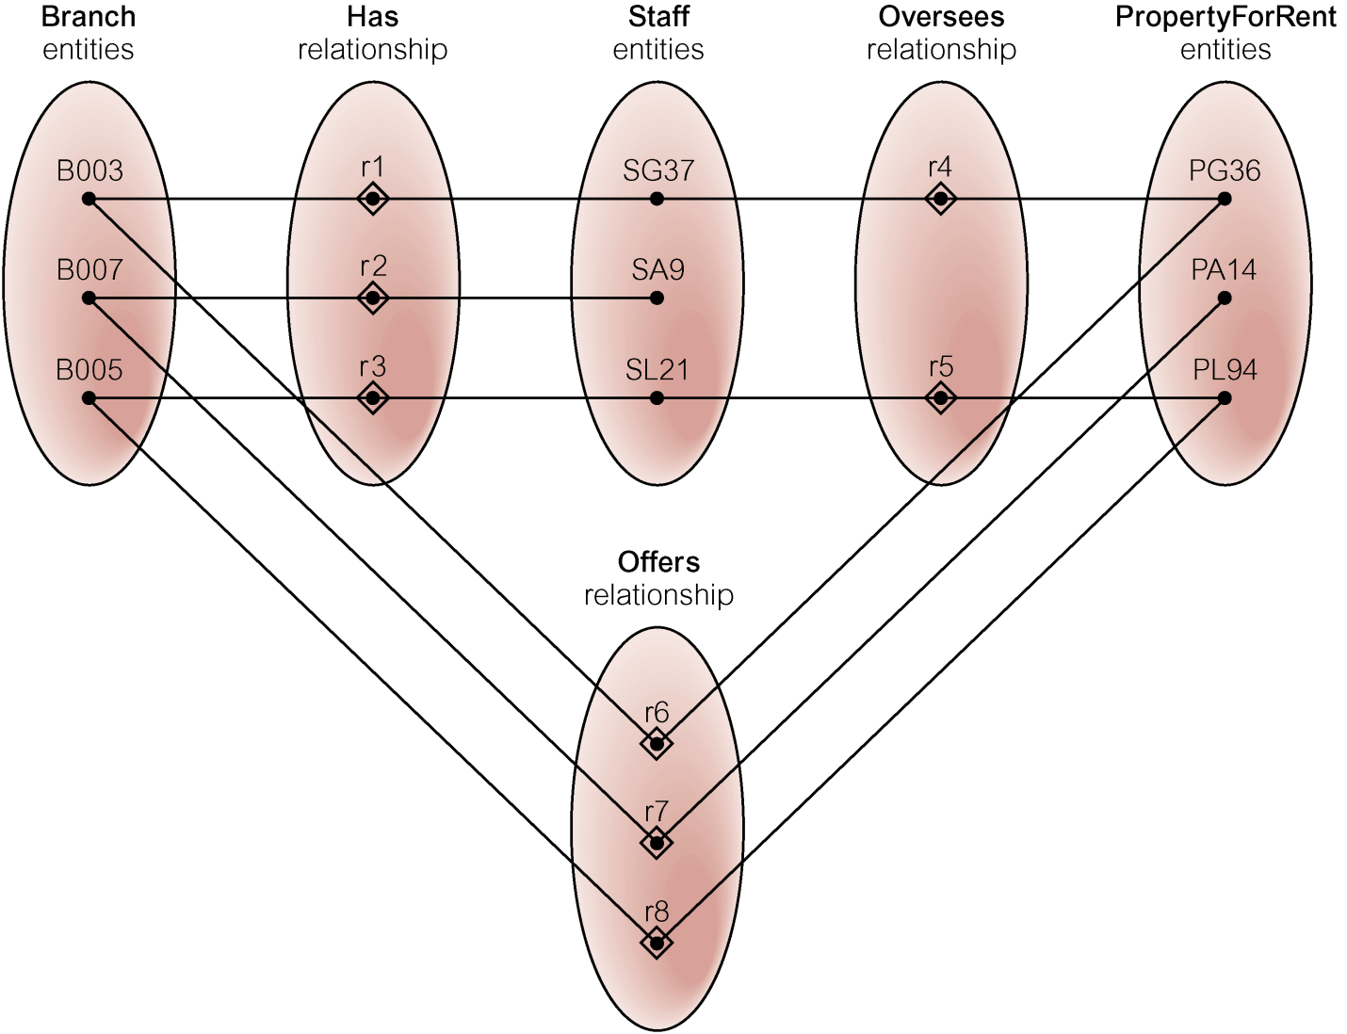
Semantic Net of Restructured ER Model with Chasm Trap Removed

Slide 16
The Extended Entity Relationship Model
Result of adding more semantic constructs to original entity relationship (ER) model
Diagram using this model is called an EER diagram (EERD)

Slide 17
Entity Supertypes and Subtypes
Entity supertype
  Generic entity type that is related to one or more entity subtypes
  Contains common characteristics
Entity subtypes
  Contains unique characteristics of each entity subtype

Slide 18
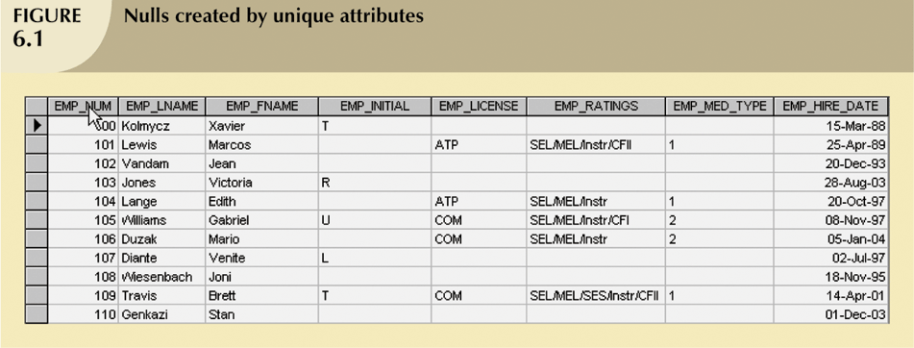
Entity Supertypes and Subtypes (continued)

Slide 19
Specialization Hierarchy
Depicts arrangement of higher-level entity supertypes (parent entities) and lower-level entity subtypes (child entities)
Relationships sometimes described in terms of “IS-A” relationships
Subtype can exist only within context of supertype and every subtype can have only one supertype to which it is directly related
Can have many levels of supertype/subtype relationships

Slide 20
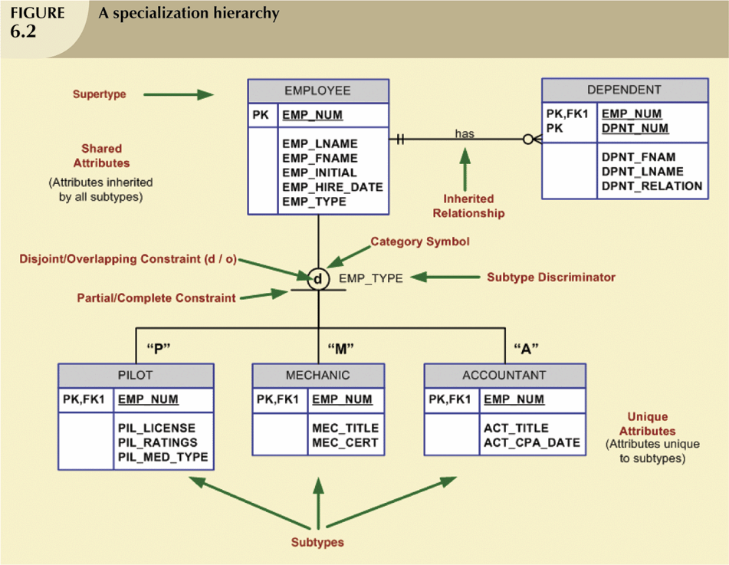
Specialization Hierarchy
(continued)

Slide 21
Specialization Hierarchy (continued)
Support attribute inheritance
Define special supertype attribute known as subtype discriminator
Define disjoint/overlapping constraints and complete/partial constraints

Slide 22
Inheritance
Enables entity subtype to inherit attributes and relationships of supertype
All entity subtypes inherit their primary key attribute from their supertype
At implementation level, supertype and its subtype(s) depicted in specialization hierarchy maintain a 1:1 relationship

Slide 23
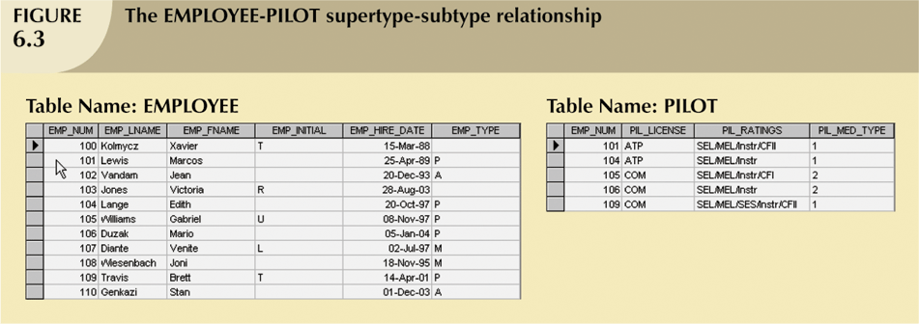
Inheritance (continued)

Slide 24
Subtype Discriminator
The attribute in supertype entity that determines to which entity subtype each supertype occurrence is related
The default comparison condition for subtype discriminator attribute is equality comparison

Slide 25
Disjoint and Overlapping Constraints
Disjoint subtypes
  Also known as non-overlapping subtypes
  Subtypes that contain unique subset of supertype entity set
Overlapping subtypes
  Subtypes that contain nonunique subsets of supertype entity set

Slide 26
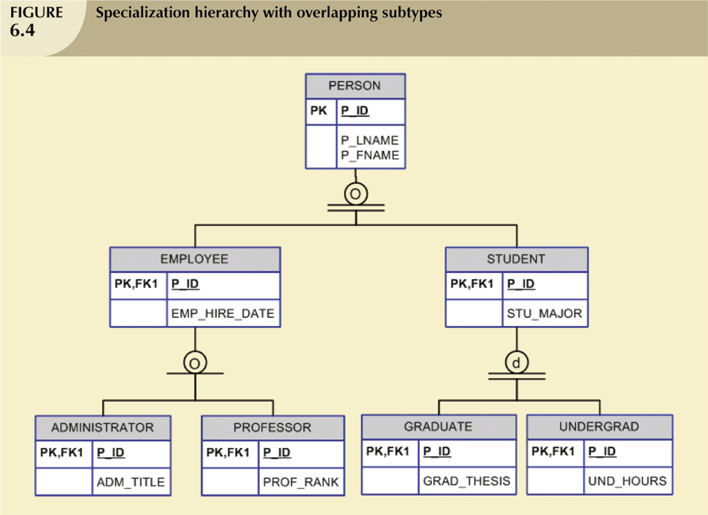
Disjoint and Overlapping
Constraints (continued)

Slide 27
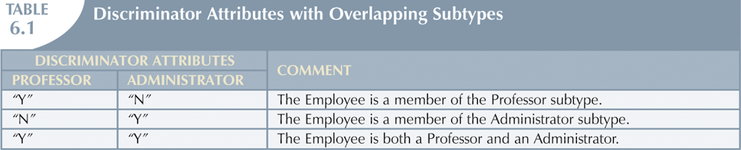
Disjoint and Overlapping
Constraints (continued)

Slide 28
Completeness Constraint
Specifies whether each entity supertype occurrence must also be member of at least one subtype
Can be partial or total

Slide 29
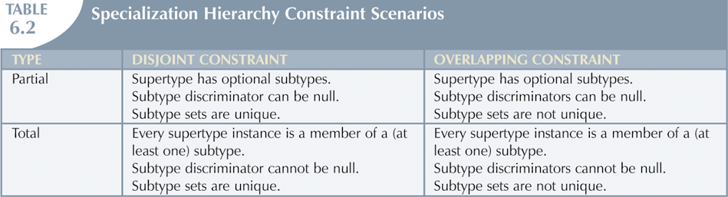
Completeness Constraint
(continued)

Slide 30
Specialization and Generalization
Specialization
  Top-down process of identifying lower-level, more specific entity subtypes from higher-level entity supertype
  Based on grouping unique characteristics and relationships of the subtypes

Slide 31
Specialization and Generalization
(continued)
Generalization
  Bottom-up process of identifying higher-level, more generic entity supertype from lower-level entity subtypes
  Based on grouping common characteristics and relationships of the subtypes

